Slide 1
CISC 130 – Section 3
Day 1: Welcome to the first day of class!
Please sit anywhere you like
If you are not officially registered for the course, please come see me

Slide 2
Quick Introductions
Name
Professor Lockwood

Slide 3
Stand up if ….
You are a freshman
You are a sophomore
You are a junior
You are a senior
You are majoring in mechanical engineering
You are majoring in electrical engineering
You are majoring in computer engineering
You are majoring in computer science
You are majoring in actuarial science
You are undeclared
Notes:
I spend a lot of time on the first day of class doing ice breakers. This allows me to get to know a little bit about the students and it also starts to get the students comfortable with each other. Since I use pair programming and group work throughout the semester, I want the students to feel comfortable working with anyone in the class.
We go through each of these options one at a time. These are the warm up questions about year in school, major, etc. I will ask follow up questions (for example, after I go through all the majors, if I notice a student didn’t stand up, I’ll as about their major).

Slide 4
Stand up if ….
You are (originally) from the twin cities
You are (originally) from a suburb
You are (originally) from Minnesota
You are (originally) from Wisconsin
You are (originally) from elsewhere in the US
You are (originally) from another country
You want an industry job after graduation
You think you might go to grad school
Notes:
Our institution draws heavily from our geographic area. If that isn’t true of your institution you might want to change these questions a little. Again, I ask follow ups, particularly if students are from outside the state or the US. Some times I’ll also ask what kind of grad school students are considering. I find that the success of this activity depends on being engaged with the student answers.

Slide 5
Stand up if ….
You are only taking this class because it is required
You think it will be useful to learn computer science for your career
You have taken a computer science class before
You have written a computer program before
You have never written a computer program before
You like group work
You hate group work
You are worried it will be hard to learn programming
You’ve heard this class is super-hard
Notes:
The course I use these slides in is a required programming course for non-majors, I acknowledge that most of the students wouldn’t take it if it weren’t a requirement and let them know that’s ok and that part of my job during the semester is to convince them that they not only need my class, but the next one in the sequence (which is not required).
I dwell a bit on the “taken a CS class/written a program” question. Almost none of my students have any prior experience. I want them to see that the same is true of their classmates. I point out that since so few people have prior experience it means that if one student has a question it is likely that other students would like to ask the same thing.

Slide 6
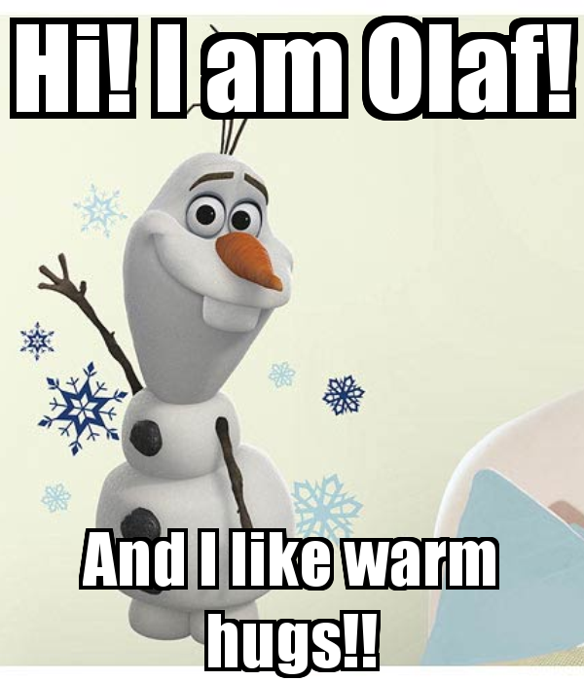
Introduction, Part II
Create a meme
Use any picture (a) of you or (b) you took
In the text, include your name and something you did over winter break/J-term
Upload to forum on Blackboard
Take note of any problems/questions you have while working on this
Notes:
This activity is designed to get students problem solving on the first day. Most students will have seen a meme but will not have created one. I purposely do not give explicit instructions on how to do this tasks/what tools to use. I want the students to try to figure it out on their own and to figure out what resources are available to them. We talk about how this process is similar to how they might approach problems in class after they finish the activity.
After all of the memes have been uploaded to the forum on our LMS, we go through them as a class. If someone has something interesting on their meme, I’ll ask a follow up question. My goals here are to get students to feel comfortable in class and to start to create a sense of community. For example, if someone has a picture of a lake and their meme says “I went to the cabin” I might ask where the cabin is.

Slide 7
Discussion
Had you made a meme before this assignment?
What questions did you have / what information did you need?
How did you find a picture? Did you have any problems?
How did you add the text? How did you know what program to use? Did you have any problems?
Did you have any problems adding the completed meme to the forum?
How and where did you save your work?
How did you find the information you needed?
What strategies did you use to work through problems you encountered?
Which of these strategies do you think will be helpful for work in this class?
Did everyone finish at the same time?
Notes:
After we go through all the memes, we have a group discussion.
Very few student have made a meme before so I talk about how that is similar to the fact that very few students have previously taken a programming course.
Then we talk about how students found help. Usually this is (1) other students (2) Google (3) asking me. We talk about how successful each strategy was. Then we talk about how to responsibly use the Internet (for example, it is totally fine to Google “how to make a meme” to understand the concepts needed but it would not be ok to Google “find a meme about winter vacation” and then turn in someone else’s work as my own – I also talk about how it would probably be pretty obvious too).
I also make sure that at some point we talk about how if a student didn’t know how to make a meme, they could break the big project (make a meme) into smaller steps (e.g. find a picture).

Slide 8
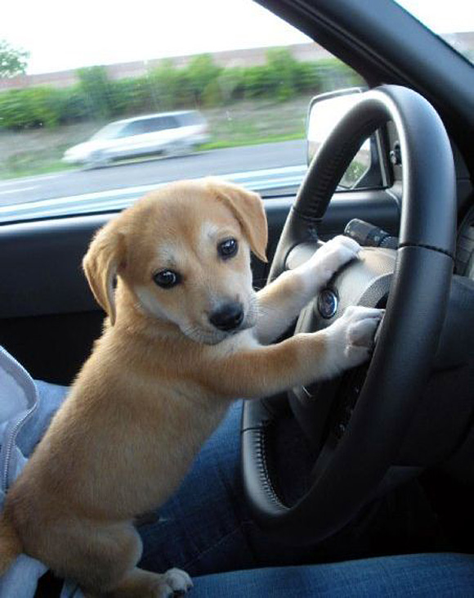
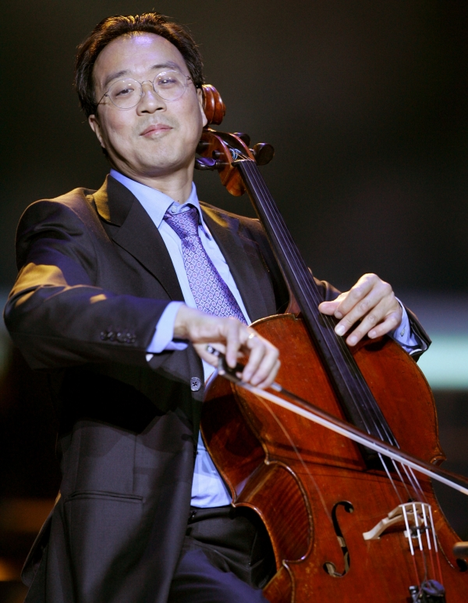
How to get good at programming
Notes:
On this slide I talk about strategies for success in learning programming. I try to make two main points
Students need to shift from a “study” mindset to a “practice” mindset. I tell students that all assessments in our class are open book, so if they are just reading notes or trying to memorize things, they are studying incorrectly. That the only way to get good at programming is to get in there and try things out. I say that programming is like driving – you wouldn’t want to be out on the road with a bunch of people who had learned how to drive only by reading a book.
That they should EXPECT to make mistakes. I talk about how in sports or music you don’t learn by doing things perfectly, but by making mistakes and then learning how to correct. I tell students that when we work on in class problems, I WANT them to make mistakes. Throughout the semester we spend a lot of time talking about how to work through mistakes and how to pick solid test cases that let you thoroughly test your code.

Slide 9
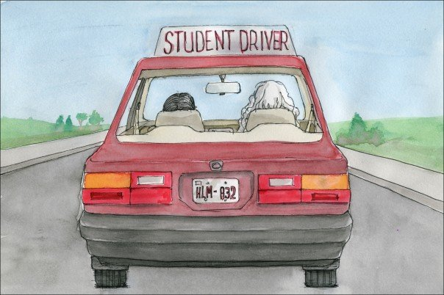
How this class is structured
You will get lots of practice programming
Homework (almost) every day before class
Review materials on Blackboard
Watch a few short videos/read text
Take practice quizzes
Minimize lecture and maximize hands-on practice
Class materials: slides, code, etc are always posted after class
Notes:
The next few slides cover how my classroom works. I use the inverted classroom in my introductory programming classes. If you are interested in learning more about how I use the inverted classroom, I have a teaching paper outlining the basics. I am also happy to chat klockwood@spa.edu

Slide 10
Other class details
No REQUIRED text book
If you like learning from textbooks, great! I am happy to make some recommendations
Check Blackboard DAILY
All course information and work will be posted on Blackboard
You are responsible for all deadlines and assignments posted
Communication
Please use your official St. Thomas email
aklockwood@stthomas.edu

Slide 11
It’s Probably on the syllabus ….
… or Blackboard
Notes:
I don’t exhaustively cover the syllabus on the first day as I devote most of the time to the ice breaker activities and the meme creation. I do give the students a quiz on the syllabus before the second day of class and let them know that they are responsible for everything it contains

Slide 12
For tomorrow
Make sure you check Blackboard
There is a pre-class workbook
Each of these should take 15-45 minutes
Introduce the topic that will be covered that day
Needs to be finished before class starts

Slide 13
Why learn programming?
Why are you here?
http://code.org/
Can you learn programming?
https://www.youtube.com/watch?v=GWSZ1DKjNzY

